Slide 1
AGGREGATE FUNCTIONS

Slide 2
SQL HAVING Clause
The HAVING clause was added to SQL because the WHERE keyword could not be used with aggregate functions.
Syntax
SELECT column_name(s) FROM table_name HAVING condition ORDER BY column_name(s);
EX:select DOCDATE,fncode from hdata having fncode='PUR1'order by docdate DESC;
select CODE,BILL from accountgroupdetails having CODE='120201';

Slide 3
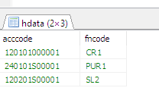
SQL GROUP BY Statement
The GROUP BY statement is often used with aggregate functions (COUNT, MAX, MIN, SUM, AVG) to group the result-set by one or more columns.
particular column has same values in different rows then it will arrange these rows in a group
SELECT column_name(s) FROM table_name WHERE condition GROUP BY column_name(s);
EX:
select acccode,fncode from hdata group by fncode

Slide 4
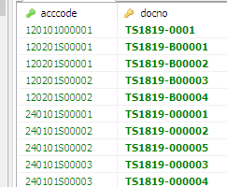
SQL EXISTS Operator
EXISTS operator returns true if the subquery returns one or more records.
SELECT column_name(s) FROM table_name WHERE EXISTS (SELECT column_name FROM table_name WHERE condition);
select acccode,docno from hdata WHERE exists ( select docno from idata where docno='TS1819-B00003');

Slide 5
SQL ANY and ALL Operators
The ANY and ALL operators are used with a WHERE or HAVING clause.
The ANY operator returns true if any of the subquery values meet the condition.
SELECT column_name(s) FROM table_name WHERE column_name operator ANY (SELECT column_name FROM table_name WHERE condition);
select acccode from hdata WHERE acccode= any (select acccode from idata where docno='TS1819-B00003');

Slide 6
SQL ALL
ALL operator returns TRUE if all of the subquery values meet the condition.
SELECT column_name(s) FROM table_name WHERE column_name operator ANY (SELECT column_name FROM table_name WHERE condition);
select acccode from hdata WHERE acccode= all (select acccode from idata where docno='TS1819-B00003');

